Slide 1
AI Tools for Business and Professional Tools
(أدوات الذكاء الاصطناعي للأعمال والأدوات المهنية)

Slide 2
outline
Intelligent Survey Analysis (تحليل الاستبيانات الذكي)
Smart Candidate Matching (مطابقة ذكية للمرشحين)
Streamlined Recruitment (توظيف مبسط)
Data Security & Anomaly Detection (أمان البيانات واكتشاف الشذوذ)
Advanced Data Analysis (تحليل البيانات المتقدم)
AI-Enhanced Survey Creation (إنشاء الاستبيانات المعزز بالذكاء الاصطناعي)
Unstructured Data Intelligence (تحليل البيانات غير المنظمة)
Content Generation (توليد المحتوى)
Strategic Foresight (الرؤية الاستراتيجية)

Slide 3


The AI Revolution in Business
Artificial Intelligence is rapidly transforming how organizations operate, offering unprecedented opportunities to enhance efficiency, accuracy, and insight across various critical functions. From talent acquisition to strategic decision-making, AI tools are becoming indispensable assets.
Efficiency Gains
Enhanced Accuracy
Automate routine tasks, freeing up human potential for more strategic work.
Minimize human error in data processing and predictive analytics.
Deeper Insights
Uncover hidden patterns and make data-driven decisions with confidence.

Slide 4

Rafa: Intelligent Survey Analysis
Rafa.ai is an innovative platform that leverages AI to analyze survey responses, providing actionable insights from qualitative data. It streamlines the process of understanding customer feedback and employee sentiment.
https://rafa.ai
Steps to Use
Practical Example
Upload survey data (text-based responses).
A company uses Rafa to analyze 1,000 open-ended employee comments from an annual engagement survey. Rafa identifies recurring themes like "work-life balance" and "career development," helping HR prioritize initiatives.
Rafa's AI processes and categorizes feedback.
Review generated themes and sentiment scores.
Export reports for strategic planning.

Slide 5

Hiring (AI Hiring Tools): Smart Candidate Matching
Hiring.ai offers a suite of AI-powered tools designed to optimize the recruitment process, from candidate sourcing to screening, ensuring a faster and more efficient hiring cycle.
https://www.hiring.ai
Steps to Use
Practical Example
Define job requirements and desired skills.
A tech startup uses Hiring.ai to find software engineers. The AI quickly sifts through thousands of resumes, identifying candidates with specific coding languages and project experience, reducing time-to-hire by 30%.
AI sources and screens candidates from various platforms.
Receive ranked list of best-fit applicants.
Initiate interviews with top candidates.

Slide 6
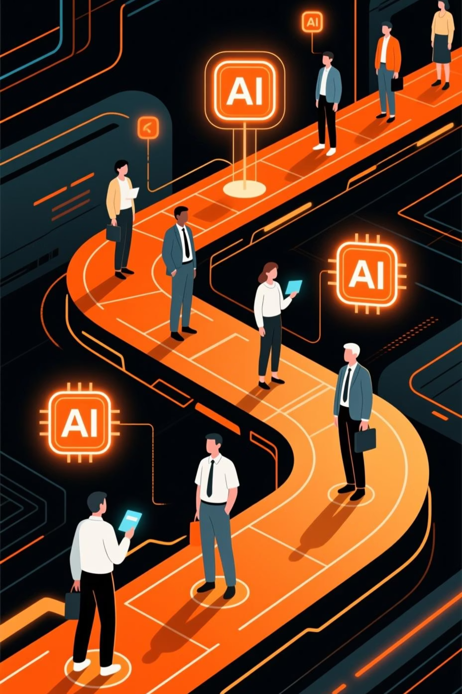
EaseMyHiring AI: Streamlined Recruitment
EaseMyHiring AI is an intelligent platform focused on simplifying and enhancing every stage of the recruitment journey, from automated job postings to smart interview scheduling and candidate assessment.
https://easemyhiring.com
Steps to Use
Practical Example
Create and publish job descriptions.
A large retail chain employs EaseMyHiring AI to manage high-volume recruitment for seasonal staff. The AI automatically schedules interviews, sends reminders, and compiles candidate feedback for hiring managers.
AI manages applicant tracking and communication.
Automate interview scheduling and reminders.
Utilize AI insights for candidate evaluations.

Slide 7

LeakSID: Data Security & Anomaly Detection
LeakSID is an advanced AI-driven tool specializing in detecting data leaks and security anomalies, safeguarding sensitive information and preventing cyber threats in real-time.
https://leaksid.com
Steps to Use
Practical Example
Integrate LeakSID with existing data systems.
A financial institution uses LeakSID to protect customer data. The AI flags an unusual data transfer attempt by an internal employee, preventing a potential data exfiltration before it occurs.
AI continuously monitors for unusual activity.
Receive instant alerts on potential breaches.
Investigate and mitigate identified risks.

Slide 8

Quadratic: Advanced Data Analysis
Quadratic.ai is a powerful platform for complex data analysis, offering advanced computational capabilities and visualization tools for data scientists and analysts to extract deep insights.
https://quadratic.ai
Steps to Use
Practical Example
Import large datasets into the platform.
A market research firm uses Quadratic to analyze consumer behavior data. The platform reveals subtle purchasing patterns linked to specific demographics, allowing for more targeted marketing campaigns.
Apply various AI models for analysis.
Visualize data trends and correlations.
Derive predictive insights for business strategy.

Slide 9

SurveyMonkey: AI-Enhanced Survey Creation
SurveyMonkey, a leading survey platform, integrates AI to assist users in crafting more effective surveys, predicting response rates, and analyzing open-ended text to generate faster, deeper insights.
https://www.surveymonkey.com
Steps to Use
Practical Example
Use AI suggestions for question phrasing.
A university department uses SurveyMonkey's AI to design a student satisfaction survey. The AI suggests optimized question types and helps categorize hundreds of student comments into actionable feedback areas.
Distribute surveys to target audiences.
AI analyzes qualitative responses for themes.
Generate comprehensive reports with key takeaways.

Slide 10

Relevance AI: Unstructured Data Intelligence
Relevance AI specializes in extracting valuable insights from unstructured data, such as customer reviews, social media posts, and support tickets, transforming raw text into organized, actionable intelligence.
https://relevanceai.com
Steps to Use
Practical Example
Upload diverse unstructured data sources.
A product development team uses Relevance AI to analyze thousands of online product reviews. The AI identifies emerging feature requests and common pain points, guiding the next iteration of their product roadmap.
AI processes and clusters similar topics.
Identify trends, sentiment, and key entities.
Monitor changes over time and inform strategy.

Slide 11

Albus AI: Content Generation
An AI-powered platform specializing in creating high-quality, SEO-optimized articles, blog posts, and marketing copy at scale, tailored to specific brand voices.
A marketing agency uses Albus AI to generate 50 unique blog posts per month for diverse clients, drastically reducing content creation time and cost while consistently improving organic search rankings.

Slide 12

WhiteRabbitNeo: Strategic Foresight
An advanced AI designed for strategic market analysis and predictive modeling, identifying emerging trends, potential disruptions, and optimal investment opportunities.
Steps to Use
Practical Example
Analyze market data and competitive landscapes
A venture capital firm leverages WhiteRabbitNeo to analyze vast datasets, forecasting the next big technological shift and guiding their investment decisions in early-stage startups with high growth potential.
Identify emerging trends and disruptions
Generate predictive models for future scenarios
Guide strategic investment and business decisions

